Slide 1
Discussions and attitudes about COVID-19 vaccine on Twitter: A text mining analysis
By: Melissa Vang, Raheyma Khan, Shivani Garlapati, Sreni Sureneni, Deeksha Poornashri
Notes:
Melissa Vang will present

Slide 2

Overview
Introduction
Methods/Approaches
Discussion
Conclusion
Future Work/ Limitation
References
Notes:
Melissa Vang will present

Slide 3
Introduction
COVID-19 vaccine is the most discussed topic on Twitter in recent times
Data was collected from Twitter
The goal of our project was to study the Twitter messages related to COVID-19 vaccine and analyze the people’s attitude and reaction towards the vaccine and also analyze how it has affected and continues to affect the economy and people’s life
Analyzed tweets during the month of September 2020
Notes:
Sreni Sureneni will present:
COVID-19 vaccine is the most discussed topic on Twitter in recent times. The high quality data was collected from Twitter.
The goal of our project was to study the Twitter messages related to COVID-19 vaccine and analyze the people’s attitude and reaction towards the vaccine and also analyze how it has affected and continues to affect the economy and people’s life.
We analyzed Twitter messages collected during the month of September 2020.

Slide 4
Introduction
Research question / 4 approaches
What are people's attitudes towards the COVID-19 vaccine? How have COVID-19 affected people’s lives?
Explore the positive, negative, and neutral tweets and do a topic modeling.
Collect the tweet locations.
Locate famous people on Twitter and create an analysis from the individuals’ tweets and the general users.
Extract covid19vaccine hashtag and use count statistics analysis.
Notes:
Sreni Sureneni will present Read of the research question and 4 approaches

Slide 5
Research Question
What are people's attitudes towards the Covid-19 vaccine? How has Covid-19 affected people’s lives?
Extracted tweets with covid-19 vaccine related hashtags
Conducted a Sentiment Analysis using Support Vector Machine (SVM) trained on Google Play Reviews data
Notes:
Raheyma Khan will present

Slide 6
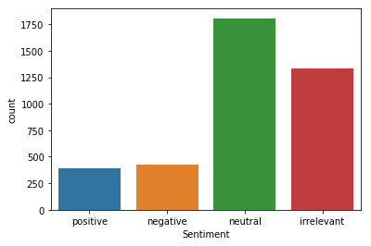
Sentiment Analysis 01:
Training Dataset: Neik Sanders’ Corpus of over 5000 Hand-Classified Tweets
Uneven Distribution - High Quantity of Neutral Tweets
Notes:
Raheyma Khan will present

Slide 7
Sentiment Analysis 01: Training SVM Model
Split the training dataset into 80% train and 20% test
Fit TF-IDF Based SVM model on train data
Predict test data using trained SVM model
Notes:
Raheyma Khan will present

Slide 8

Sentiment Analysis 01: Covid-19 Data
Snscrape - extracted covid-19 vaccine tweet ids using hashtags
Tweepy - extracted text and location of tweets using tweet ids extracted by snscrape
Notes:
Raheyma Khan will present

Slide 9
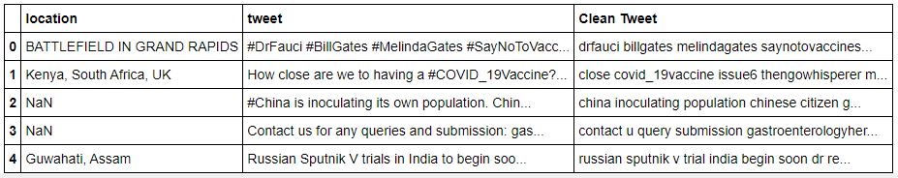
Sentiment Analysis 01: Covid-19 Data
Cleaned Covid-19 Dataset - lower casing, removing links, punctuation and stop words, and lemmatizing.
Notes:
Raheyma Khan will present

Slide 10
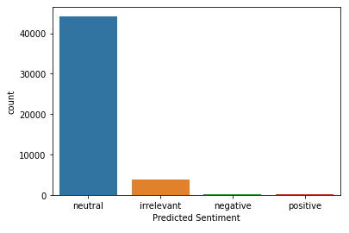
Sentiment Analysis 01: Results on Covid-19 Data
Almost all Covid-19 Vaccine Tweets classified as Neutral.
Not a good result!
Notes:
Raheyma Khan will present

Slide 11
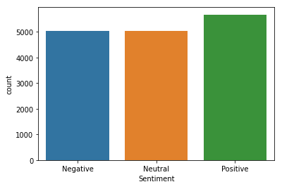
Sentiment Analysis 02: Training Dataset
Training Dataset: Google Play App Reviews dataset with over 15000 annotated reviews
Equal Distribution of Sentiment
Notes:
Raheyma Khan will present

Slide 12
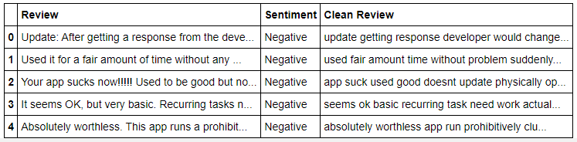
Sentiment Analysis 02: Training Dataset
Cleaned Training Dataset - lower casing, removing links, punctuation and stop words, and lemmatizing.
Notes:
Raheyma Khan will present

Slide 13
Sentiment Analysis 02: Training SVM Model
Split the training dataset into 80% train and 20% test
Fit TF-IDF Based SVM model on train data
Predict test data using trained SVM model
Notes:
Raheyma Khan will present

Slide 14
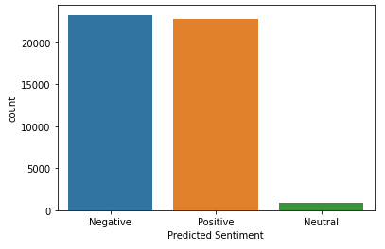
Sentiment Analysis 02: Results
Approximately equal quantity of Positive and Negative sentiments.
Very few Neutral sentiment tweets
Notes:
Raheyma Khan will present

Slide 15
Four Analyses
Separate positive, negative, and neutral tweets and find main topics in the tweets.
Conduct sentiment analysis based on location.
Compare sentiments of famous people about covid-19 vaccine with their followers.
Conduct statistics analysis on covid-19 vaccine related hashtags..
Notes:
Raheyma Khan will present

Slide 16
Analysis 01: Topic Modeling
Remove top 10 frequent words from covid-19 data to get better topics
Separate positive, negative and neutral tweets
Construct a dictionary (id2word) and a document-term matrix
(corpus) for all three types of tweets
Find optimal number of topics
Apply LDA and LSA topic models
Notes:
Raheyma Khan will present

Slide 17
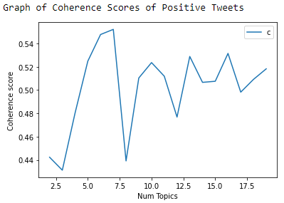
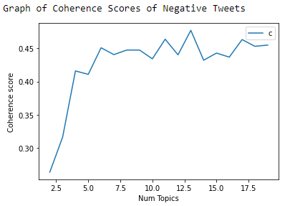
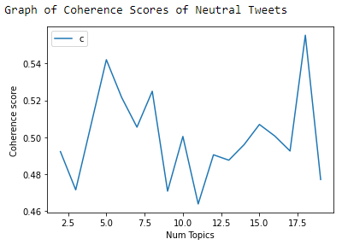
Topic Modeling: LDA Model
Positive Tweets
Negative Tweets
Neutral Tweets
Optimal Topics = 7
Optimal Topics = 13
Optimal Topics = 17
Notes:
Raheyma Khan will present

Slide 18

LDA Model: Positive Topics
Notes:
Raheyma Khan will present

Slide 19

LDA Model: Negative Topics
Notes:
Raheyma Khan will present

Slide 20

LDA Model: Neutral Topics
Notes:
Raheyma Khan will present

Slide 21
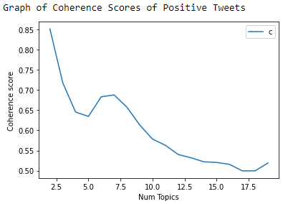
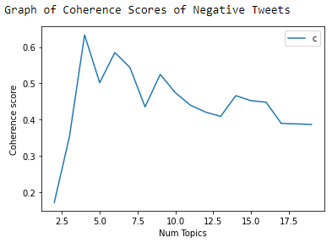
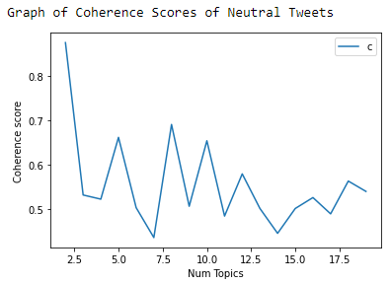
Topic Modeling: LSA Model
Positive Tweets
Negative Tweets
Neutral Tweets
Optimal Topics = 2
Optimal Topics = 4
Optimal Topics = 2
Notes:
Raheyma Khan will present

Slide 22
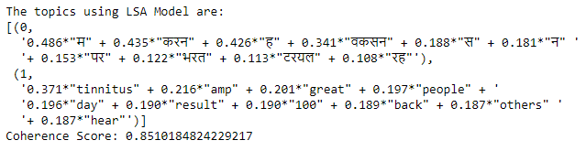
LSA Model: Positive Topics
Notes:
Raheyma Khan will present

Slide 23
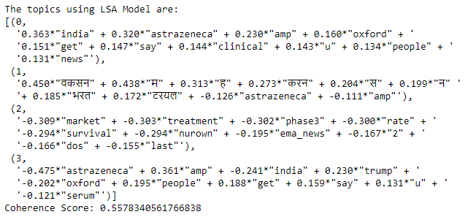
LSA Model: Negative Topics
Notes:
Raheyma Khan will present

Slide 24
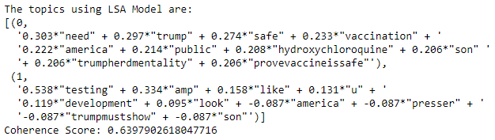
LSA Model: Neutral Topics
Notes:
Raheyma Khan will present

Slide 25
Analysis 02: Sentiments in Different Countries
Get the country of each tweet
Keep tweets of countries with more than 100 tweets
Create a grouped bar plot with positive, negative and neutral tweets from each country
Notes:
Raheyma Khan will present

Slide 26
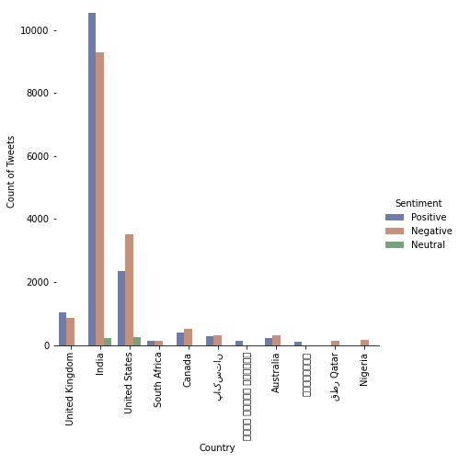
Sentiments in Different Countries
Notes:
Raheyma Khan will present

Slide 27
Analysis 02: Sentiments in Different Cities
Get the city, latitude and longitude of each tweet
Count number of positive and negative tweets from each city
Assign a sentiment to each city based on number of positive and negative tweets
Plot a world map with sentiments of cities
Notes:
Raheyma Khan will present

Slide 28
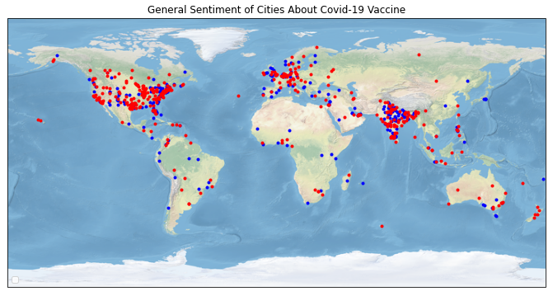
Sentiments in Different Cities
Notes:
Raheyma Khan will present

Slide 29
Analysis 03: Sentiments of Famous People and their Followers
Look at covid-19 vaccine tweets from famous people -
Donald Trump and Joe Biden
Use TF-IDF Based SVM Model to predict sentiments of the followers of Trump and Biden
Compare sentiments of famous people and their followers
Notes:
Shivani Garlapati will present

Slide 30
Famous Person: Donald Trump
“STOCK MARKET UP BIG, VACCINE COMING SOON. REPORT 90% EFFECTIVE. SUCH GREAT NEWS!”
Extract screen names of Donald Trump’s followers - 17065 followers
Separate covid-19 tweets of Trump’s followers
Use the SVM Model to predict sentiments of Trump’s followers’ tweets.
Plot a bar graph for the result
Notes:
Shivani Garlapati will present

Slide 31
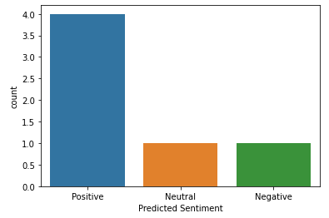
Famous Person: Donald Trump
There is a high number of positive tweets from Trump’s followers
Trump’s followers have sentiments similar to him
Notes:
Shivani Garlapati will present

Slide 32
Famous Person: Joe Biden
“Today's news of a second vaccine is further reason to feel hopeful. What was true with the first vaccine remains true with the second: we are still months away. Until then, Americans need to continue to practice social-distancing and mask-wearing to get the virus under control.”
Extract screen names of Joe Biden’s followers - 12396 followers
Separate covid-19 tweets of Biden’s followers
Use the SVM Model to predict sentiments of Biden’s followers’ tweets.
Plot a bar graph for the result
Notes:
Shivani Garlapati will present

Slide 33
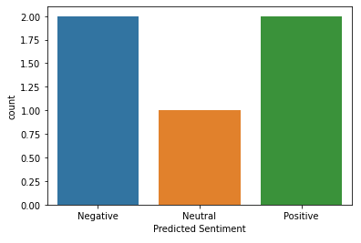
Famous Person: Joe Biden
There is an equal proportion of positive and negative sentiments in Biden’s followers
Though Biden has a moderately positive sentiment, his followers have mixed opinions
Notes:
Shivani Garlapati will present

Slide 34
Analysis 04: Count Statistics Analysis on Hashtags
Extract hashtags from all the covid-19 vaccine tweets
Count the number of occurrences of each hashtag
Notes:
Shivani Garlapati will present

Slide 35
Count of Hashtags
#coronavirusvaccine | 27423
#covidvaccine | 20463
#coronavirus | 17666
#covid19 | 17516
#coronavaccine | 15053
#astrazeneca | 1920
#russia | 1494
#sputnikv | 1471
#who | 1278
#china | 1244
#oxfordvaccine | 1187
#russianvaccine | 778
#donaldtrump | 772
#trump | 695
#seruminstitute | 629
Notes:
Shivani Garlapati will present

Slide 36
Conclusion
Based on our data, people have approximately equal proportion of positive and negative sentiments to the covid-19 vaccine
LSA Model gives us topics with very high coherence scores
India has a more positive outlook to the vaccine, while USA has a more negative outlook
The hashtags most commonly used with covid-19 vaccine hashtags are #astrazeneca, #donaldtrump, #who, #sputnikv, #russianvaccine, etc.
Notes:
Shivani Garlapati will present

Slide 37
Further Work
Evaluate people's attitudes towards the COVID-19 vaccine in other social media applications
Notes:
Shivani Garlapati will present

Slide 38
Limitations
Analyzed Twitter messages and collected data for the month of September 2020, small dataset
More “covid19” related hashtags
Notes:
Shivani Garlapati will present

Slide 39
References
Abd-Alrazaq, A., Alhuwail, D., Househ, M., Hamdi, M., & Shah, Z. (2020, April 21). Top Concerns of Tweeters During the COVID-19 Pandemic: Infoveillance Study. Retrieved from https://www.ncbi.nlm.nih.gov/pmc/articles/PMC7175788/
Al-Masri, A. (2019, February 13). Creating The Twitter Sentiment Analysis Program in Python with Naive Bayes Classification. Retrieved from https://towardsdatascience.com/creating-the-twitter-sentiment-analysis-program-in-python-with-naive-bayes-classification-672e5589a7ed
Johnson, A. F., Pollock, W., & Rauhaus, B. (2020). Mass casualty event scenarios and political shifts: 2020 election outcomes and the U.S. COVID-19 pandemic. Administrative Theory & Praxis, 42(2), 249-264. https://doi.org/10.1080/10841806.2020.1752978
Ned Temko Correspondent. (2020, August 11). The COVID “vaccine war” that everybody loses. Christian Science Monitor, N.PAG.
Notes:
Shivani Garlapati will present

Slide 40
GitHub Repository: https://github.com/vamel19/Group-3-covid-vaccine
Sentiment Analysis of Covid-19 Vaccine Tweets with Niek Sanders’ Annotated Data:
https://github.com/raheymakhan/Term-Project-Code/blob/main/Sentiment%20Analysis%20of%20Covid%20Vaccine%20Tweets%20-%20with%20Neik%20Sanders'%20Annotated%20Data.ipynb
Sentiment Analysis of Covid-19 Vaccine Tweets with Google Play Reviews Annotated Data:
https://github.com/raheymakhan/Term-Project-Code/blob/main/Sentiment%20Analysis%20of%20Covid%20Vaccine%20Tweets%20-%20with%20PlayStore%20Reviews%20%20Annotated%20Data.ipynb

Slide 41
Coding
Analysis 01 - Topic Modeling on Positive, Negative and Neutral Tweets
https://github.com/raheymakhan/Term-Project-Code/blob/main/Analysis%2001%20-%20Topic%20Modeling%20on%20Positive%2C%20Negative%20and%20Neutral%20Tweets.ipynb
Analysis 02 - Comparing Sentiments in Different Cities and Countries
https://github.com/raheymakhan/Term-Project-Code/blob/main/Analysis%2002%20-%20Comparing%20Sentiments%20in%20Different%20Cities%20and%20Countries.ipynb

Slide 42
Coding
Analysis 03 - Comparing Sentiments of Famous People with their Followers
https://github.com/raheymakhan/Term-Project-Code/blob/main/Analysis%2003%20-%20Comparing%20Sentiments%20of%20Famous%20People%20with%20their%20Followers.ipynb
Analysis 04 - Count Statistics Analysis on Hashtags
https://github.com/raheymakhan/Term-Project-Code/blob/main/Analysis%2004%20-%20Count%20Statistics%20Analysis%20on%20Hashtags.ipynb

Slide 43
Thank you! Any questions?
Notes:
Shivani Garlapati will present

